Slide 1
Garbage Bin Level Prediction and Collection
Batch No: 12

Slide 2
Team Members:
KRISSHANTH R - CB.EN.U4ELC22021
PRAVEENKUMAR U S - CB.EN.U4ELC22056
PRANAV KARTHIKEYAN - CB.EN.U4ELC22062
PRANAV VENKATESWARAN - CB.EN.U4EEE22127

Slide 3
Table of contents
01
02
03
04
Aim of the Project
Problem Statement & Solution
Methodology
Dataset Overview

Slide 4
01
Aim of the Project
The primary objective is to develop an intelligent system capable of accurately classifying garbage bins as “Full” or “Not Full” using real-time sensor data and machine learning.
Optimized Waste Management: The system aims to enhance the efficiency of waste collection, predicting when bins reach capacity.
Environmental Impact: By minimizing overflows and reducing fuel consumption, the system contributes to lowering carbon emissions and improving urban sanitation.
Societal Benefits: This solution can lead to cost savings for municipalities and improved public health, making cities cleaner and more sustainable.

Slide 5
Table of contents
01
02
03
04
Aim of the Project
Problem Statement & Solution
Methodology
Dataset Overview

Slide 6
Problem Statement & Solution
02
Traditional waste management methods rely on static schedules or manual monitoring, leading to overflows, inefficiencies, and increased operational costs.
Inefficient Scheduling: Fixed collection schedules often result in bins being emptied too early or too late, causing either resource wastage or overflow incidents.
Lack of Real-Time Data: Manual monitoring is prone to errors and delays, preventing timely interventions and optimization of collection routes.
Proposed Intelligent System: Our approach integrates multiple sensor readings (fill level, battery status, temperature, location, and time) to automatically classify bin status.
Advanced Machine Learning: By employing algorithms such as CatBoost, K Neighbour Classifier, and Decision Tree classifiers, the system delivers high accuracy in predictions and facilitates dynamic routing of waste collection vehicles.

Slide 7
Table of contents
01
02
03
04
Aim of the Project
Problem Statement & Solution
Methodology
Dataset Overview

Slide 8
Methodology
03
The project’s methodology comprises several interconnected phases:
Data Collection: Real-time data is gathered using an array of sensors attached to garbage bins. An ultrasonic sensor measures fill levels, while onboard sensors record environmental parameters and battery status.
Preprocessing and Feature Engineering: Raw sensor data is cleaned, normalized, and transformed. Temporal features (like hour and day) and spatial features (like location coordinates) are engineered to enhance model performance.

Slide 9
Table of contents
01
02
03
04
Aim of the Project
Problem Statement & Solution
Methodology
Dataset Overview

Slide 10
Dataset Overview
04
The dataset is central to training an accurate model and includes:
Comprehensive Sensor Data: Attributes such as date, time, ultrasonic sensor readings (converted to fill level in litres/percentage), temperature, battery level, and geographical coordinates are collected.
Labeling for Classification: Data is labeled as “Full” or “Not Full” based on predetermined thresholds, facilitating binary classification.
Data Cleaning and Preprocessing: Steps include removal of null values, conversion of string attributes to numerical values, and the use of regular expressions to cleanse sensor data.
Feature Engineering: Temporal attributes (hour, day of week) and spatial features (location encoded as one-hot vectors) are generated, and SMOTE is applied to handle class imbalance effectively.

Slide 11
Table of contents
04
05
06
07
Dataset Overview
ML Models
Results
Challenges and Solutions

Slide 12
ML Models
05
The ML component of the project involves training multiple classifiers to achieve the best predictive performance:
CatBoost Classifier: Chosen for its robustness with heterogeneous data and minimal tuning requirements, it excels at handling categorical features alongside numerical data.
K-Nearest Neighbors (KNN): Provides a baseline with a simple, instance-based approach, particularly effective after scaling and balancing the data using SMOTE.
Decision Tree Classifier: Offers high interpretability, enabling an understanding of decision boundaries and feature importance.
Model Evaluation: Performance metrics include accuracy, precision, recall, F1-score, ROC-AUC, and Cohen’s Kappa Score. Visualizations such as heat maps of confusion matrices and ROC curves are used to compare models.
Justification: The ensemble of these models provides a comprehensive analysis, and the best model is selected based on its balance of predictive performance and runtime efficiency.

Slide 13
Table of contents
04
05
06
07
Dataset Overview
ML Models
Results
Challenges and Solutions

Slide 14
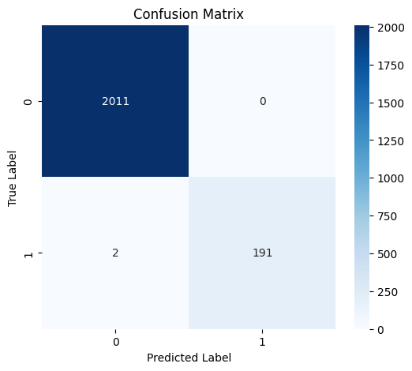
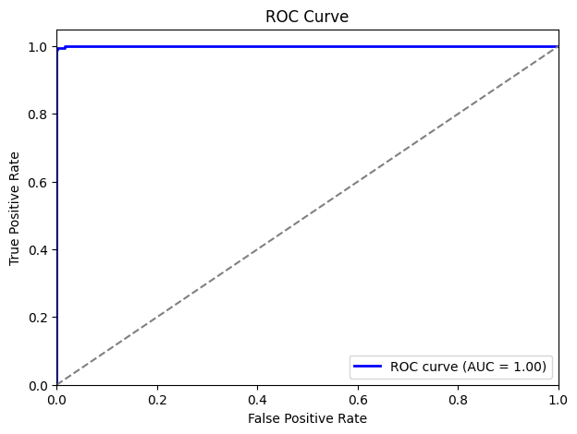
Results
06
(1) CatBoost Algorithm:
Accuracy: 0.99
Precision: 1.0
Recall: 0.989
F1-Score: 0.99
Cohen’s Kappa Score: 0.99
Training time = 6.3s
Fig. 1 Confusion Matrix
Fig. 2 ROC Curve

Slide 15
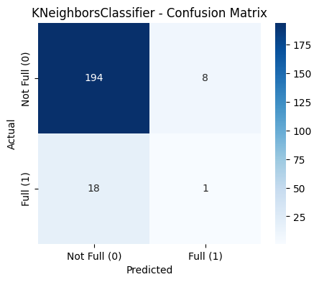
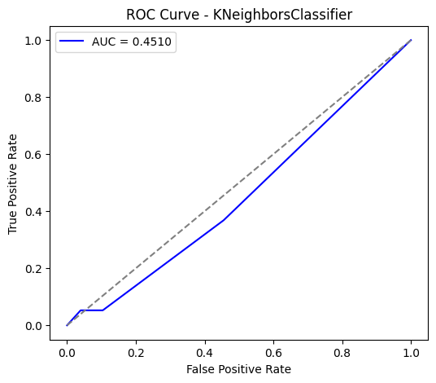
Results
06
(2) k-Neighbours Classifier Algorithm:
Accuracy: 0.88
Precision: 0.11
Recall: 0.05
F1-Score: 0.07
Cohen’s Kappa Score: 0.01
Training time = 4.67s
Fig. 1 Confusion Matrix
Fig. 2 ROC Curve

Slide 16
Results
06
(3) Decision Tree Classifier:
Accuracy: 0.63
Precision: 0.09
Recall: 0.36
F1-Score: 0.14
Cohen’s Kappa Score: 0.01
Training time = 4.35s
Fig. 1 Confusion Matrix
Fig. 2 ROC Curve

Slide 17
Table of contents
04
05
06
07
Dataset Overview
ML Models
Results
Challenges and Solutions

Slide 18
Challenges and Solutions
07
Several challenges were encountered and addressed during the project:
Data Quality and Preprocessing: Handling noisy sensor data and missing values was critical. Robust cleaning methods and the application of SMOTE ensured a balanced and high-quality dataset.
Model Selection and Tuning: Choosing the right model among CatBoost, KNN, and Decision Tree was challenging. A comparative analysis using multiple performance metrics helped in selecting the optimal classifier.
Real-Time Constraints: Ensuring that the system could operate in near real-time required optimizing both the sensor sampling rate and the model inference speed. Code optimization and hardware tweaks were implemented to achieve this.
Scalability Considerations: Strategies for scaling the system to a larger urban environment were developed, including potential integration with IoT platforms for wider data collection.

Slide 19
Table of contents
07
08
Challenges and Solutions
Future Work
09
Conclusion

Slide 20
Future Work
08
Opportunities for further development include:
Enhanced Sensor Fusion: Integration of additional sensors (e.g., gas sensors, optical sensors) could provide a more comprehensive picture of bin conditions.
Scalability and Collaboration: Expanding the system to cover larger areas and collaborating with municipal bodies for broader deployment.
Advanced Analytics: Incorporating predictive maintenance and further optimizing collection routes using advanced analytics and real-time data streams.
Algorithmic Enhancements: Exploring ensemble methods or stacking classifiers to further boost predictive performance.
Research and Development: Continued research on feature engineering and model fine-tuning will help adapt the system to evolving urban environments and data complexities.
Edge ML Deployment: Implementing real-time garbage tank fill prediction using the Arduino Nano 33 BLE Sense with Edge Impulse for low-latency, energy-efficient processing at the edge.

Slide 21
Table of contents
07
08
Challenges and Solutions
Future Work
09
Conclusion

Slide 22
Conclusion
09
The project successfully demonstrates an intelligent approach to waste management through real-time sensor integration and machine learning:
Innovative Waste Management: By automating the classification of garbage bins, the system improves efficiency and reduces operational costs.
Positive Impact: This system not only streamlines waste collection but also contributes to environmental sustainability by reducing fuel usage and lowering emissions.
Proof of Concept: The model's high performance metrics and rapid inference times provide a strong foundation for future deployment in smart cities.

Slide 23
Thank You

